Slide 1

MEMORY MANAGEMENT USING PAGING AND SEGMENTATION
SUBMITTED BY – SUBMITTED TO –
SANAM BHARDWAJ ASS.PROF MISS. PRAGTI JAMWAL
RAHUL SHARMA
ADITYA SHARMA
VAIBHAV JAMWAL

Slide 2
CONTEXT
1.What is Memory Management
2.Paging
3.Paging: advantage & disadvantage
4.Segmentation
5.Segmentation:Pros &Cons
6.Program

Slide 3

WHAT IS MEMORY MANAGEMENT?
Memory management can be defined as the process of controlling and coordinating computer memory, assigning portions that are referred as blocks, to various running programs to improve the overall system performance. The operating system, programs, applications, and hardware all have memory management systems.

Slide 4
PAGING
Paging is a memory management scheme that eliminates the need for contiguous allocation of physical memory. The process of retrieving processes in the form of pages from the secondary storage into the main memory is known as paging. The basic purpose of paging is to separate each procedure into pages.

Slide 5
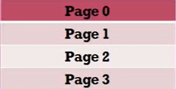
Paging
Paging is an example of non contignous-memory allocation.
Non-contignous memory allocation means wherever is a free space then operating system can allocate the free space for the corresponding process.
That means the memory location need not be in contiguous location
Pages
the process is divided into a numbe of partition called pages
The size of each page must be same
If page0 size is one 1KB then the remaining page size is also must be 1KB
The page size and frame size

Slide 6
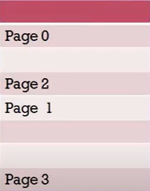
Main memory is also divided into number of partitions called
FRAMES
The size of each frame must be same that means if first frame size is 1KB the the remaining frame size also must be 1KB

Slide 7
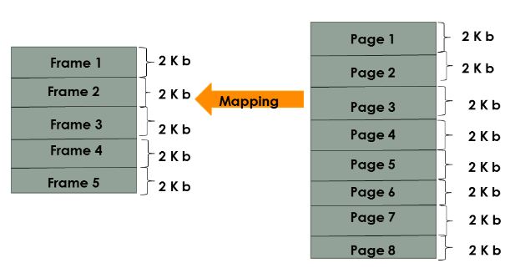

Slide 8
SEGMENTATION
In Operating Systems, Segmentation is a memory management technique in which, the memory is divided into the variable size parts. Each part is known as segment which can be allocated to a process. The details about each segment are stored in a table called as segment table. Segment table is stored in one (or many) of the segments.

Slide 9
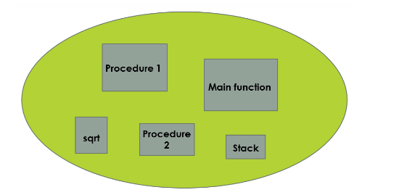
SEGMENTATION

Slide 10
PROGRAM FOR MEMORY MANAGEMENT USING PAGING AND SEGMENTATION

Slide 11
Memory management using paging
#include <stdio.h>
#include <stdlib.h>
#define MAX 50
int main()
{
int page[MAX], i, n, f, ps, off, pno;
int choice = 0;
printf("\nEnter the no of peges in memory: ");
scanf("%d", &n);
printf("\nEnter page size: ");
scanf("%d", &ps);
printf("\nEnter no of frames: ");
scanf("%d", &f);
for (i = 0; i < n; i++)
page[i] = -1;
printf("\nEnter the page table\n");
printf("(Enter frame no as -1 if that page is not present in any frame)\n\n");
printf("\npageno\tframeno\n-------\t-------");
for (i = 0; i < n; i++)
{
printf("\n\n%d\t\t", i);
scanf("%d", &page[i]);
}

Slide 12
do
{
printf("\n\nEnter the logical address(i.e,page no & offset):");
scanf("%d%d", &pno, &off);
if (page[pno] == -1)
printf("\n\nThe required page is not available in any of frames");
else
printf("\n\nPhysical address(i.e,frame no & offset):%d,%d", page[pno], off);
printf("\nDo you want to continue(1/0)?:");
scanf("%d", &choice);
} while (choice == 1);
return 1;
}
Memory management using segmentation
struct list
{
int seg;
int base;
int limit;
struct list *next;
} *p;

Slide 13
void insert(struct list *q,int base,int limit,int seg)
{
if(p==NULL)
{
p=malloc(sizeof(struct list));
p->limit=limit;
p->base=base;
p->seg=seg;
p->next=NULL;
}
else
{
while(q->next!=NULL)
{
q=q->next;
printf(“yes");
}
q->next=malloc(sizeof(struct list));
q->next ->limit=limit;
q->next ->base=base;
q->next ->seg=seg;
q->next ->next=NULL;
}
}

Slide 14
int find(struct list *q,int seg)
{
while(q->seg!=seg)
{
q=q->next;
}
return q->limit;
}
int search(struct list *q,int seg)
{
while(q->seg!=seg)
{
q=q->next;
}
return q->base;
}
void segmentation()
{
p=NULL;
int seg,offset,limit,base,c,s,physical;
printf("Enter segment table\n");
printf("Enter -1 as segment value for termination\n");

Slide 15
do
{
printf("Enter segment number");
scanf("%d",&seg);
if(seg!=-1)
{
printf("Enter base value:");
scanf("%d",&base);
printf("Enter value for limit:");
scanf("%d",&limit);
insert(p,base,limit,seg);
}
}while(seg!=-1);
printf("Enter offset:");
scanf("%d",&offset);
printf("Enter bsegmentation number:");
scanf("%d",&seg);
c=find(p,seg);
s=search(p,seg);
if(offset<c)
{
physical=s+offset;
printf("Address in physical memory %d\n",physical);
}

Slide 16
else
{
printf("error");
}
}
int main()
{
int choice;
while(choice!=3)
{
printf("1.paging \n 2.segmetation \n 3.quit \n enter your choice:");
scanf("%d",&choice);
if(choice==1)
{
paging();
}
else if(choice==2)
{
segmentation();
}
else if(choice==3)
printf("you quit");
}
}

Slide 17
THANK YOU

